Slide 1
Tony’s Pure Systems
Water purification systems & electronics
http://Tonyspuresystems.com

Slide 2
When you invest in a water purification system, you are investing in you and your family’s good health. Here’s why. Our water treatment centers have been recycling sewage water and sending it right back to us to drink.
Reverse osmosis water purifiers

Slide 3
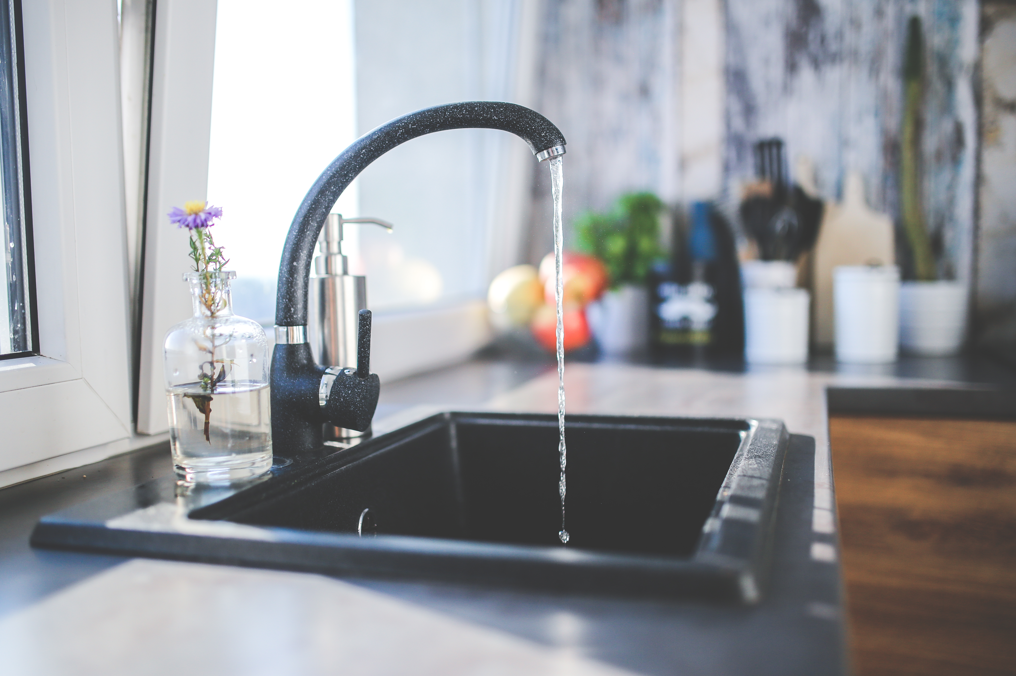
Reverse osmosis systems are really the answer to our city dirty water problems. Tap water has been tested to contain over a hundred contaminants and very dangerous to your health.
This Photo by Unknown Author is licensed under CC BY

Slide 4
Bottled Water compared to Reverse Osmosis Systems
Bottled Water
Reverse osmosis systems
There is a chemical compound called BPA (Bisphenol A) which is made with plastic to make it harder and more durable.
This chemical has bas been found to leak into your water after left in a hot car. And it will cause cancer.
Now imagine how long the bottled water remained in a hot truck while on delivery to its destiny. Maybe cross country.

Slide 5
Farming Industry
Farming & Pesticides
Pesticides & Herbicides
Here is more reasons why we should test our ground water as well.
Well water use to be considered safe to drink. But farming agriculture with pesticides and herbicides, has contaminated ground water.
So that tells us that our ground water is not safe till tested.
Chemical Tests on groundwater must be done to be considered safe before drinking ground water.
This Photo by Unknown Author is licensed under CC BY-ND

Slide 6
Our city underground and house pipes.
But, because of the city recycling sewage water and sending it right back to us to drink, our pipes will be full of Arsenic, magnesium, amongst metals like Copper, Aluminum, Iron, and calcium but not the kind you find in a banana or milk.
They use chlorine to kill the bacteria in the sewer water. But they do not use reverse osmosis systems.
The reason why is because it would be to expensive for them to maintain amd replace many filtration systems.
This Photo by Unknown Author is licensed under CC BY-SA-NC

Slide 7
The Solution to the Problem
Reverse osmosis systems produce pure good quality alkaline water.
Bottled water turns yellow with a chemical test done on it. Because it is acidic, and acidic cells are housing for cancer cells to live and grow in.
Alkaline water turns blue or purple depending on the alkalinity.
The alkalinity of alkaline water is on a ph level from 7 to 14.

Slide 8
TONY’S WATER PURIFICATION SYSTEMS
https://tonysuresystems.com: When you invest in a water purification system, you are investing in you and your family's good health. Here is why. Because our city water treatment centers are recycling sewage water and sending it right back to us to drink. Read more about it on my website.
Feel free to join any or my free affiliate programs on my website.
Reference: Tony’s Pure Systems LLC. (2020)

